Slide 1
Summer internship project (pool b)
Submitted By:- Swati Dhoundiyal (2018014148)
Kartik Patadia (2018001395)
Akshat Arora (2018006551)
Simran Mohakud (2018009803)

Slide 2

Stock Market Analysis And Prediction

Slide 3
Problem Statement:-
Explanation:
Our aim is to create software that analyses previous stock data of certain companies, with help of certain parameters that affect stock value. We are going to implement these values in data mining algorithms. This will also help us to determine the values that particular stock will have in near future. We will determine the Month’s High and Low with help of data mining algorithms.

Slide 4
Pre-requisites:-
One need to know basics of programming languages like C , C++, Python. You should know concepts of Variables, Operators, Conditional Statements, Loops etc.
SOFTWARE
Python 3:-
Python 3.0 was released on December 3, 2008. It was designed to rectify fundamental design flaws in the language. The guiding principle of Python 3 is: "reduce feature duplication by removing old ways of doing things".
Anaconda Navigator:-
Anaconda is a free and open-source Python distribution and collection of hundreds of packages related to data science, scientific programming, development and more. Python is included in the Anaconda distribution. It is not an IDE though it can be configured with most IDEs. It also comes with a platform-agnostic package manager called conda.
Spyder:-
Spyder is an open source cross-platform integrated development environment (IDE) for scientific programming in the Python language. Spyder integrates with a number of prominent packages in the scientific Python stack including NumPy, SciPy, Matplotlib, pandas, IPython, SymPy and Cython, as well as other open source software. It is included in the Anaconda Navigator itself.

Slide 5
Pre-requisites:-
HARDWARE
Modern Operating System
Windows 7 or 10
Mac OS X 10.11 or higher, 64-bit
Linux: RHEL 6/7, 64-bit (almost all libraries also work in Ubuntu)
x86 64-bit CPU (Intel / AMD architecture)
4 GB RAM
5 GB free disk space

Slide 6
The Project Is Based On:-
Data Mining Algorithm.
Data mining is the process of discovering predictive information from the analysis of large databases.
The desired outcome from data mining is to create a model from a given data set that can have its insights generalized to similar data sets.
Data mining algorithm stands for both classification and regression trees. Basically, it is a decision tree learning technique that outputs either classification or regression trees.

Slide 7
Objectives And Agendas:-
The stock market.
Is it possible to predict the future price of a stock?
Fundamental Analysis.
Technical Analysis.
SQL server analysis services.
Designing a hidden Markov Model for this problem.
What’s Next?

Slide 8
What We Have Tried To Do In This Project?
We have collected data of RELIANCE company’s stocks from previous year . To be precise, of year 2019 from a site.
We have collected two sets of data i.e. :-
Training data set
Test data set
We have used different modules such as:
Keras:- Keras is a minimalist Python library for deep learning that can run on top of Theano or TensorFlow
Pandas.
Tensorflow Backend:- TensorFlow is an open-source symbolic tensor manipulation framework developed by Google, Inc. It is keras backend implementation.
We have used Epoch for better predictions and analysis
(An epoch is one complete presentation of the data set to be learned to a learning machine. Learning machines like feed-forward neural nets that use iterative algorithms often need many epochs during their learning phase. The more the number of Epochs added the more precise results will appear.)

Slide 9
We have used different libraries in order to implement. Such as:-
NumPy:-NumPy is a library for the Python programming language, adding support for large, multi-dimensional arrays and matrices, along with a large collection of high-level mathematical functions to operate on these arrays
Matplotlib:-Matplotlib is a plotting library for the Python programming language and its numerical mathematics extension NumPy. It provides an object-oriented API for embedding plots into applications using general-purpose GUI toolkits like Tkinter, wxPython, Qt, or GTK+.
Basically we have collected previous years stock prices that were predicted back then and comparing them to the actual stock prices of that time. We are checking how precise the prediction was. And on that basis design a proper Markov Model using machine learning to predict the prices of stock on the upcoming times.
This will not only benefit the investors helping them which stock to buy but also the company to be aware of the upcoming stock prices of their company and work accordingly.

Slide 10
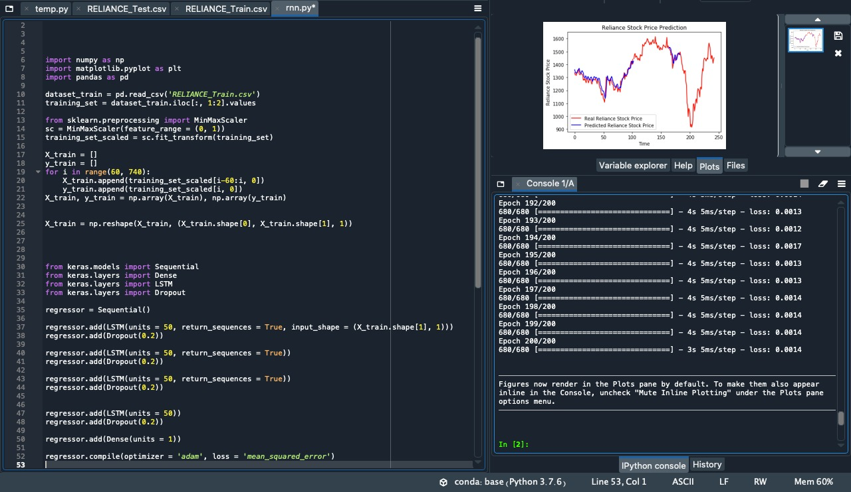
SCREENSHOT OF THE MAIN CODE
Expected Plot of the Predicted vs. Actual Stock.
Epoch used to read the data over 200 times again and again for better prediction.

Slide 11
THANK YOU

